Slide 1


Computer Security and Forensics
Research
Dr Z. Cliffe Schreuders
Reader in Computer Security
Director, Cybercrime & Security Innovation Centre
Leeds Beckett University

Slide 2
Overview
What computer security is
Why it matters (to everyone!)
Leeds Beckett and computer security research

Slide 3

Digital is ubiquitous

Slide 4
Digital makes everyone more effective

Slide 5
Attackers
Because they can
Organised crime
Financially motivated
Corporate espionage (gather information)
Insider threats (disgruntled employees)
Hacktivists
Botnet operators
Government sponsored attacks

Slide 6
Security is hard to get right

Slide 7










Slide 8
Security can be fun

Slide 9


Slide 10
Security impacts everyone
Software developers
System/network administrators
Everyone needs to be educated on security procedure to manage risk

Slide 11
Some of my earlier research projects
Access controls / sandboxing
Banking malware
Wi-Fi networks and human factors

Slide 12
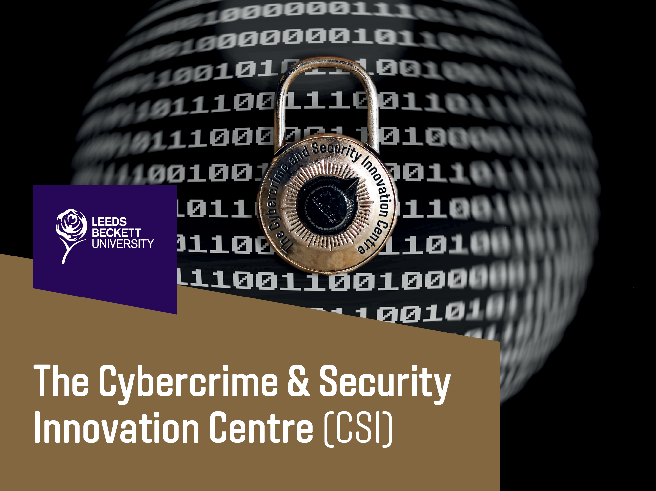

Slide 13
The Cybercrime & Security Innovation Centre
“The CSI Centre aims to improve and incorporate an evidence-based approach into the frontline policing of digital forensics and cybercrime investigations, and to advance human factors of computer security and forensics mechanisms and practice.”
“A collaborative hub for high quality research, with a collegial, supportive and cooperative research-intensive group, aimed at high-impact outputs.”
Partnerships and collaboration

Slide 14
Current projects
£1.5m in recent funding
In partnerships with industry, academia, and police
The CARI Project
Knowledge Transfer Partnerships
Nuclear Power Plant Safety
European Union Agency for Network and Information Security (ENISA)
Randomised hacking challenges
Hosting Capture The Flag hacking competitions for universities and schools

Slide 15
SecGen
SecGen is a Ruby application that uses Vagrant, and Puppet to quickly create randomly vulnerable virtual machines, based on specified scenarios
Can be used for learning or CTF events
Easily extendible: scenarios, and modules
https://github.com/cliffe/SecGen

Slide 16


Slide 17
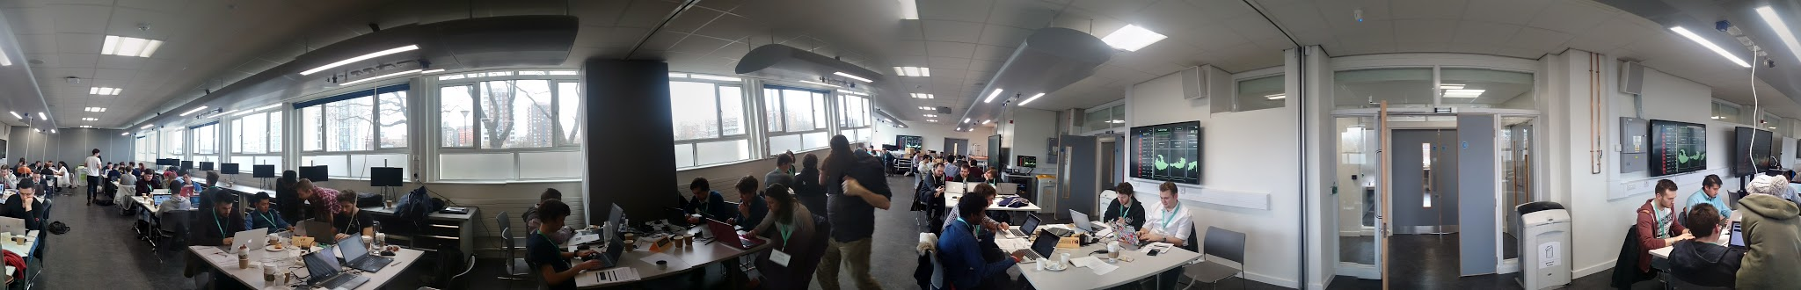
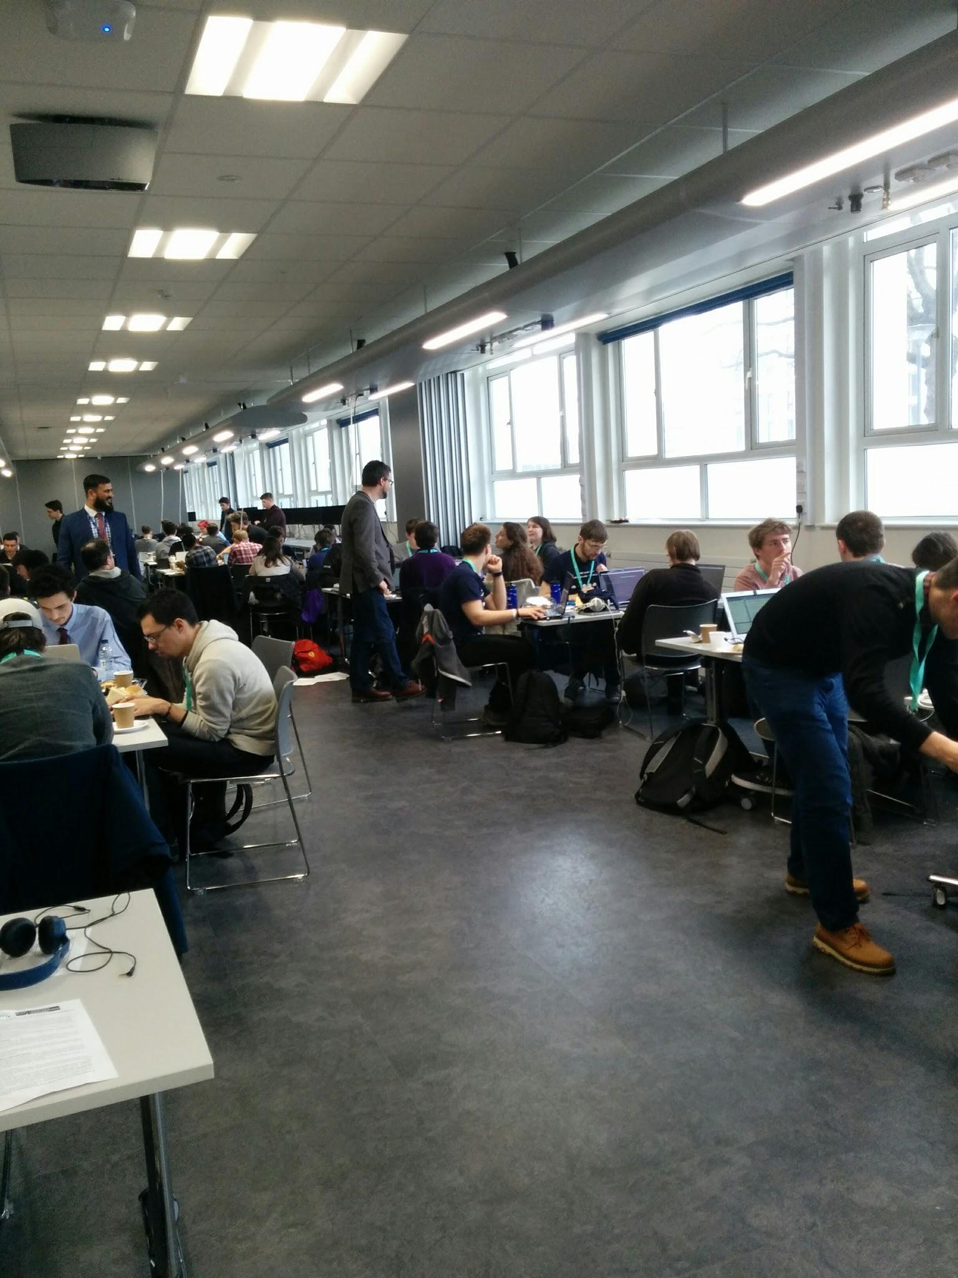
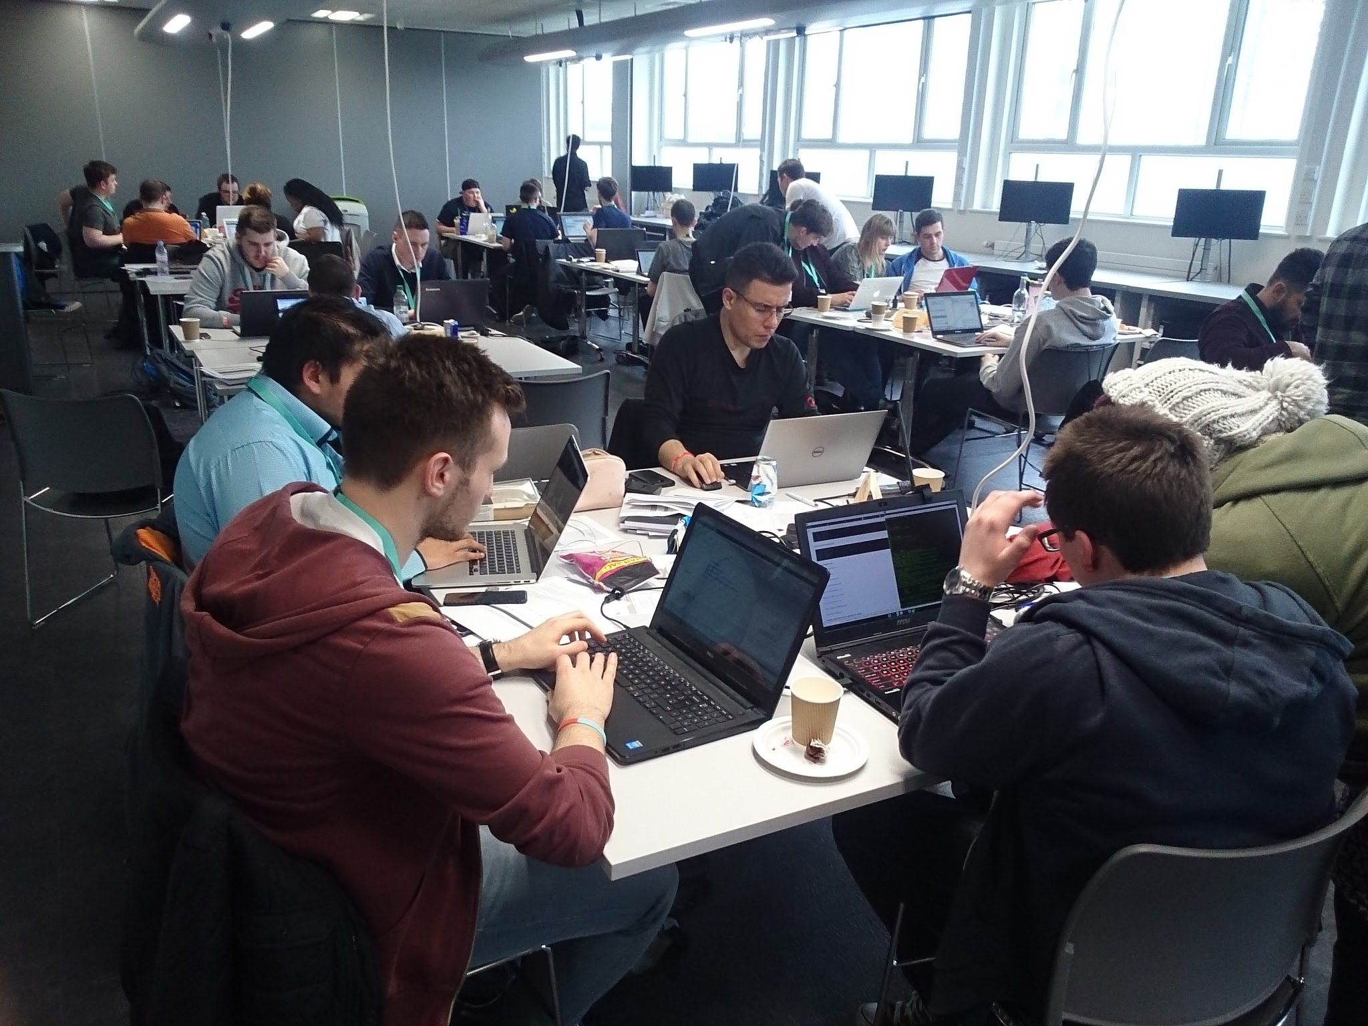
Current projects

Slide 18


Slide 19



The bid
‘An evidence-based approach to fighting cybercrime from the frontline: improving the effectiveness and efficiency of investigating cyber enabled crime’
£640,000 funded by the Police Knowledge Fund
Home Office, College of Policing, Higher Education Funding Council for England (HEFCE)

Slide 20





The bid partners
Leeds Beckett University
West Yorkshire Police
Steering Group:
WYP West Yorkshire for Innovation (WyFi)
College of Policing
Canterbury Christ Church University
CENTRIC Sheffield Hallam University

Slide 21
Starting with a needs assessment
Over 24 hours of interviews and focus groups
Investigated the entire lifecycle of investigations regarding cybercrime and digital evidence

Slide 22
Research training
All members of DFU and CCT received research training
4 x full day of research methods, with sessions for developing research ideas
Research methods: including qualitative and quantitative techniques
Research ideas development
Development into research proposals
Supported by online materials and ongoing research meetings

Slide 23
Nine workstreams
Automated forensic analysis
Image linkage for victim identification and framework for image fingerprint management
Automated grooming detection
Frontline officer awareness development and decision support mobile app
Assessment of methods of cyber training
Framework for seizure, preservation and preservation of cloud evidence
An evaluation of the role of the Digital Media Investigator within WYP
Characteristics of victims of cybercrime
Broadcast media artefacts

Slide 24
Outcomes: Technical and software
Advances in digital forensics analysis approaches
Improvements to the use of image processing for digital forensics (SPN)
Automated chat log processing for grooming detection
A mobile app for front-line police for training and decision support

Slide 25
Outcomes: Improved understanding
Best practice guidelines and procedures for the police force making use of technologies
Needs assessment results of WYP in terms of cybercrime and digital investigation
Statistical insights into classes of victims of cybercrime
An evaluation of the role of Digital Media Investigators
An assessment of styles of cybercrime training within WYP

Slide 26

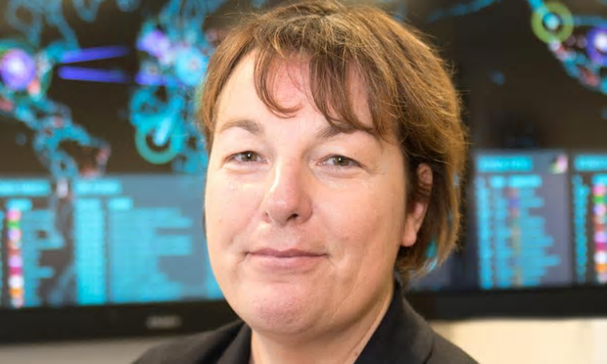
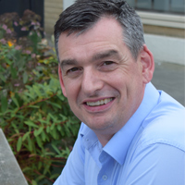

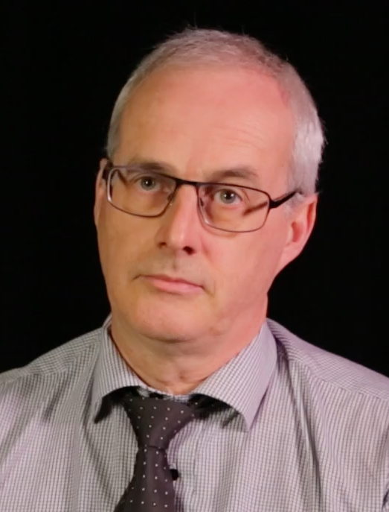
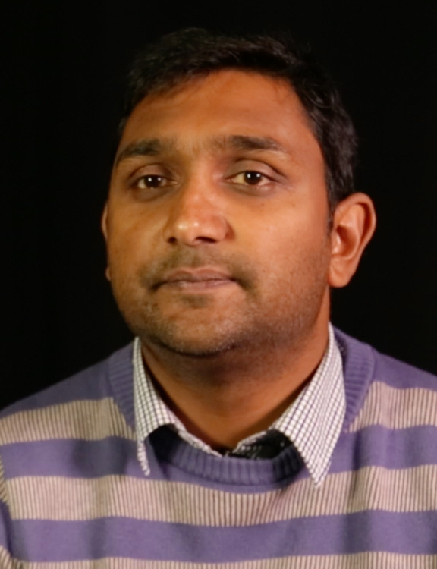


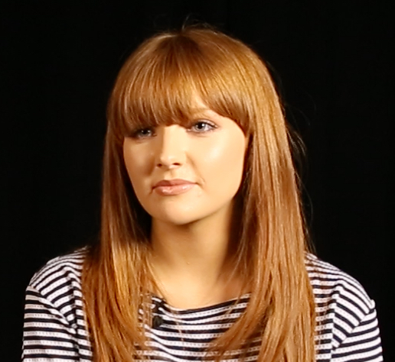
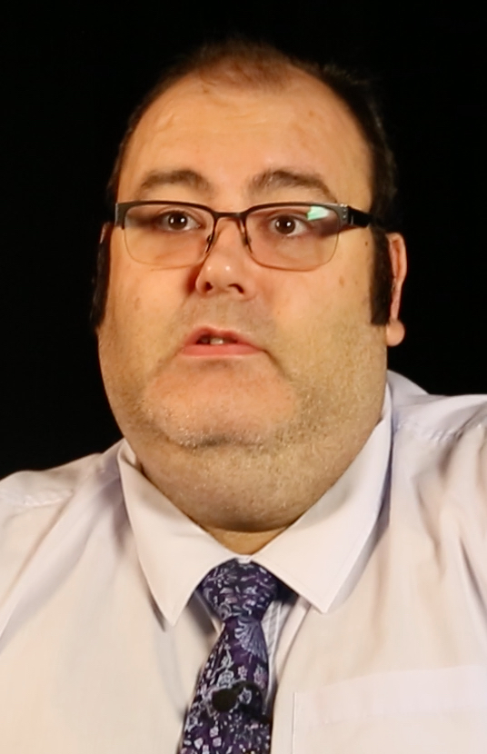

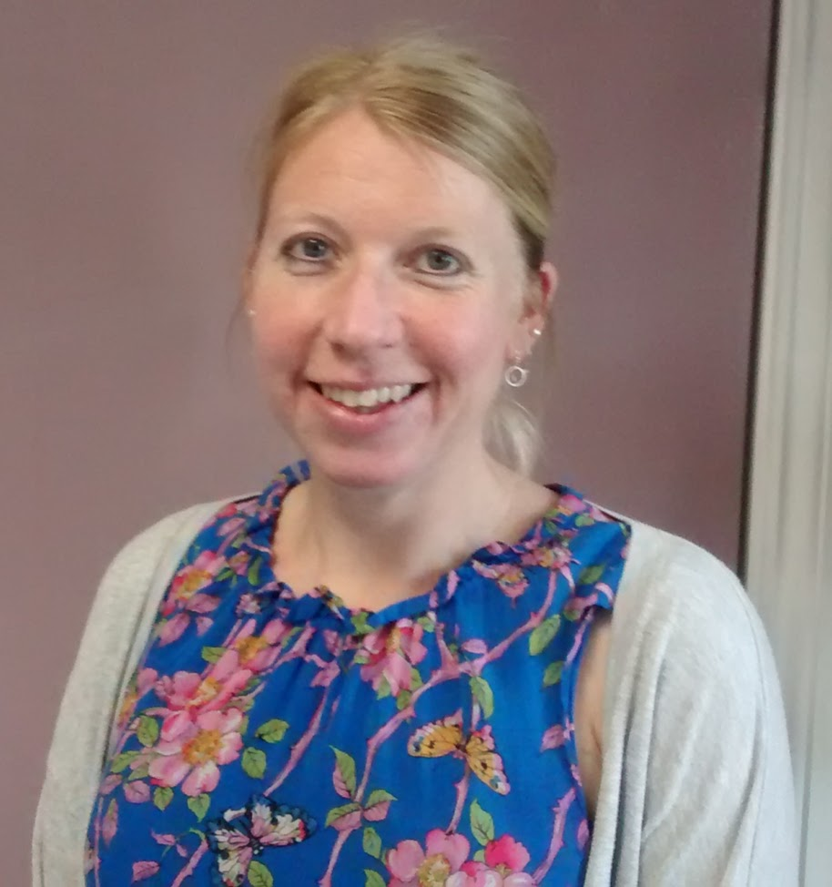

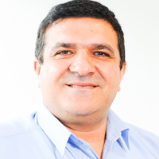








Slide 27
Needs Assessment

Slide 28
Analytic tools
Kaufman’s Organizational Elements Model (OEM)
Traditional SWOT analysis
Interviews were transcribed; and coded under each of the OEM+SWOT nodes
Needs were identified
Needs were the subject of a thematic analysis
Kaufman's Organizational Elements Model (OEM)
 | INPUTS | PROCESSES (Means) | PRODUCTS (En route results) | OUTPUTS (Delivered to society) | OUTCOMES (Effects in or for society)
WHAT IS
WHAT SHOULD BE

Slide 29
Sample
Contact Communication Centre (4 participants)
Strategic Leads for Training (3 participants)
Covert Authorities Bureau (4 participants)
Cyber Crime Team (2 participants)
District Strategic Lead (1 Participant)
Dedicated Source Unit (2 participants)
Digital Forensics Unit (3 participants)
District Staff (7 participants)
Economic Crime Unit (2 participants)
Strategic Lead for Communications (1 participant)
Strategic Leads for Intelligence (2 participants)
Investigative Analysts and Researchers (6 participants)
Homicide and Major Enquiry Team (2 participants)
Strategic Lead for Safeguard and Central Governance (1 participant)
Strategic Lead for Murder and Serious Crime (1 participant)
Technical Support Unit (2 participant)
Telecoms staff (2 participants)
Strategic Lead for Telecoms (1 participant)

Slide 30
Results
Thanks to an openness to the need for improvement, the focus groups and interviews produced data that identified a large number of issues within the force...
With practical needs that can be addressed to mitigate those issues.
A total of 125 needs were identified
Our needs assessment report presents a detailed summary results from each of the cohorts

Slide 31
Thematic Analysis of Needs
National input
Face-to-face
Interactions with the public
New capabilities
Triage
Common themes identified include:
Knowledge/training
Communication
Recording
Software
Roles
Governance
Procedures
Resources
Consistency
Staffing

Slide 32
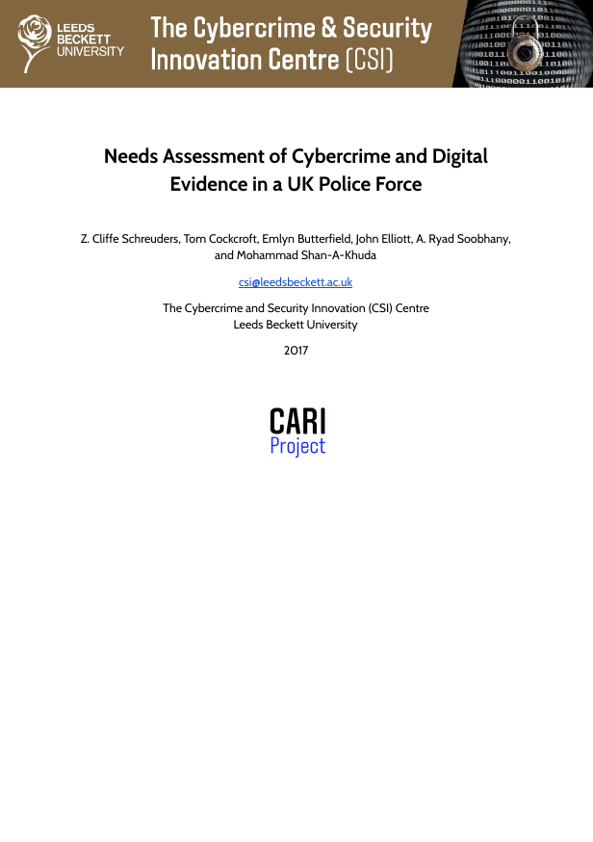
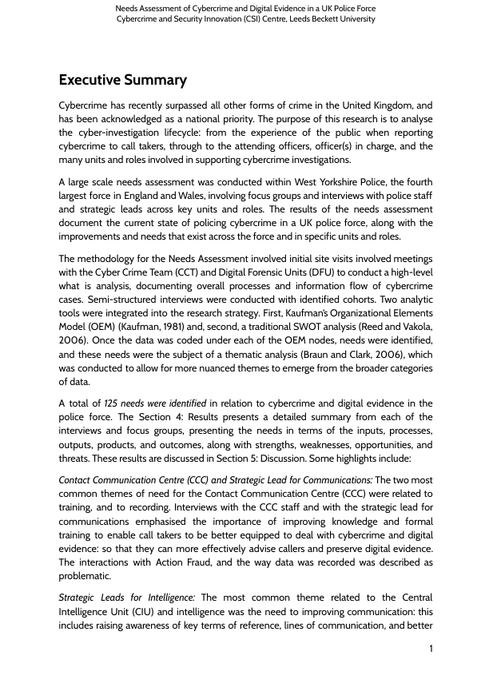
Output
124 page report

Slide 33
Frontline officer decision support mobile app

Slide 34
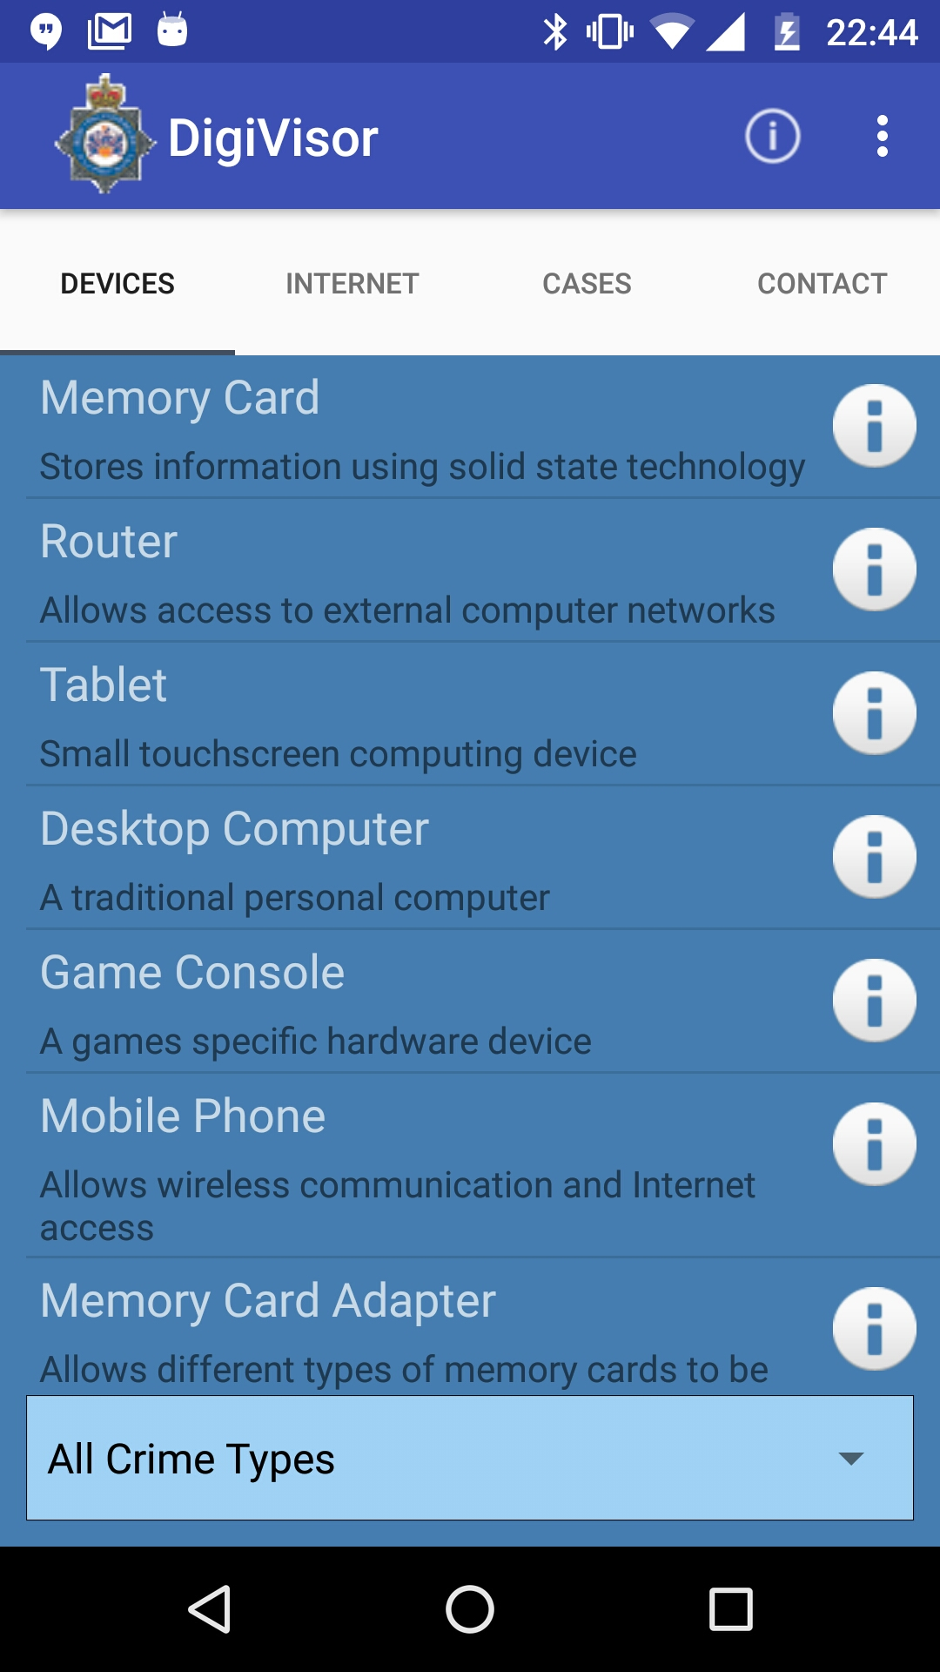

Slide 35
In app Video Training
Hugo Smith

Slide 36
Animated training videos
Notes:
https://drive.google.com/open?id=0B2242B82VXzZcm85MFdXUG5GM2M
(share link)

Slide 37
Image Linkage App and Framework for Camera Fingerprint Management

Slide 38
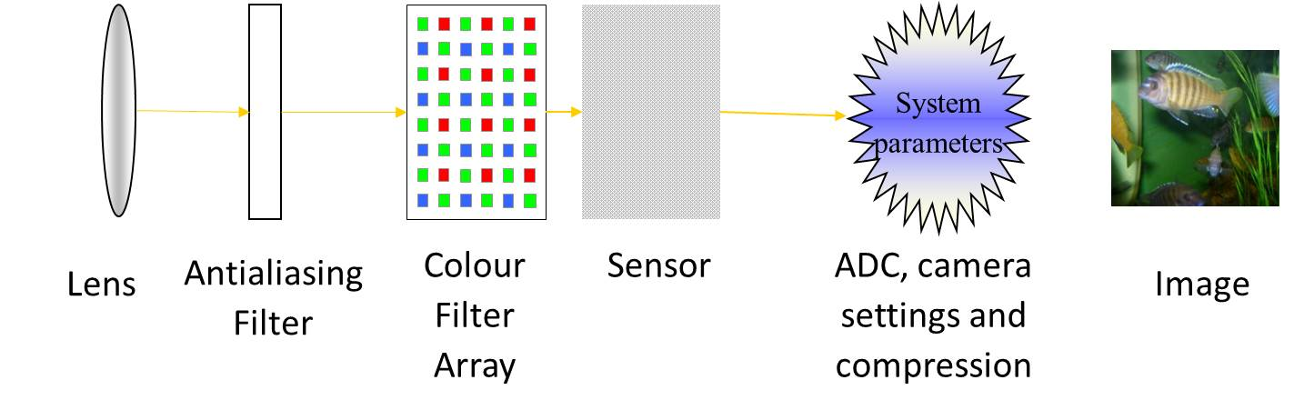
Image Acquisition Process

Slide 39
Automated Grooming Detection

Slide 40
Impact for WYP
Provide DFU with the ability to automatically scan large volumes of chat for content related to grooming
Improve investigations
Potential to include in triage processes

Slide 41
Automated Digital Forensics Analysis

Slide 42
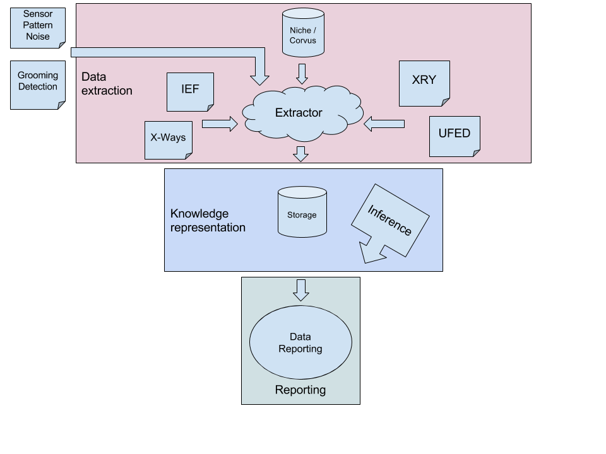
Developed Solution: Three Stages

Slide 43
Assessing the perceived effectiveness of cyber training

Slide 44
Methodology
Mixed Methods
Survey to gather a mixture of qualitative and quantitative data
Semi-structured interviews to contextualise the survey data
Survey Sample
Circa. 600 officers
Semi-Structured Interviews
Ex-trainer and an officer with Strategic Oversight of Training

Slide 45
Evaluation of the role of the Digital Media Investigator in West Yorkshire Police

Slide 46

Aims
Evaluate the role of Digital Media Investigators within West Yorkshire Police
Identify any gaps between the DMI training, support and resources currently provided and what may be required
Inform the force training school, WYP policy and the College of Policing.
"parallel lines" (CC BY-SA 2.0) by theilr

Slide 47
Characteristics of Victims of Cybercrime
Mohammad Shan-A-Khuda

Slide 48
Latent Class analysis and Cluster analysis
“Latent class analysis can best be thought of as an “improved” cluster analysis, which uses statistical (rather than mathematical) methodology to construct the results. It is based on the statistical concept of Likelihood. Parameters are estimated for: Class profiles (the description of each class) and the size of each class. An important difference is that cases are not absolutely assigned to classes, but have a probability of membership for each class.”
- Professor Brian Francis, Workshop on Methods for Analysing Crime Data on 18th and 19th May 2016 at Lancaster University

Slide 49
The Dataset
Time period: 01/07/2014 to 30/06/2016
Total cases recorded: 7,364 and Total cases included in the final analysis: 4,092 (Deletion of missing Gender and Age)
Data sources: West Yorkshire Police datasets, linked with external data sources, such as Census 2011

